Slide 1
R Stats Bootcamp 05
Data frames Ed Harris

Slide 2


Slide 3

R Stats Bootcamp
R Stats Bootcamp 05
R Data Frames
The first step in using R for data analysis is getting your data into R. The first step for getting your data into R is making your data tidy.

Slide 4
Objectives
Common data file types
Excel, data setup, and the Data Dictionary
Getting data into R
Manipulating variables in the Data Frame
Practice exercises

Slide 5
Tidy data concept
Archives data in accessible format
Data “transparent” to others
“Tidy Data” credit: Hadley Wickham (lead statistician at Posit)
Wickham 2014

Slide 6
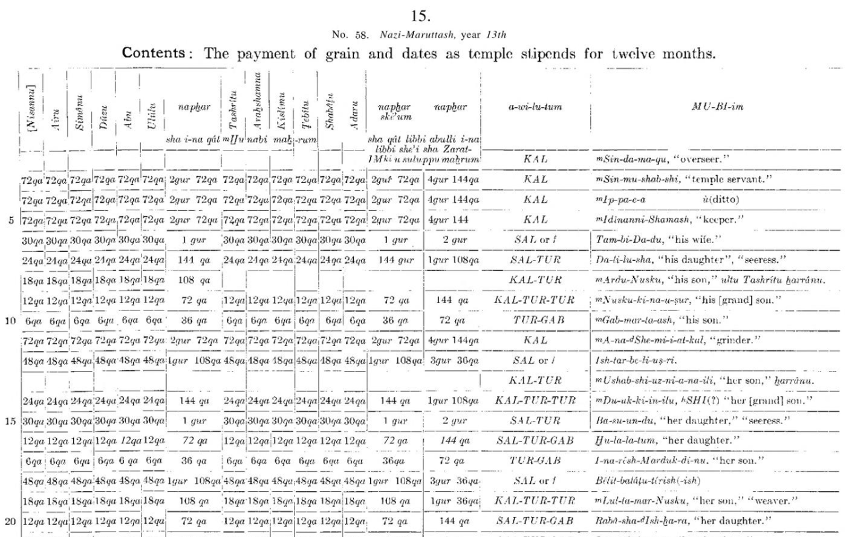
Tidy data concept

Slide 7
Common data file types
(c)sv comma separated values + others
Excel
Avoid (!) proprietary formats
Data Dictionary

Slide 8
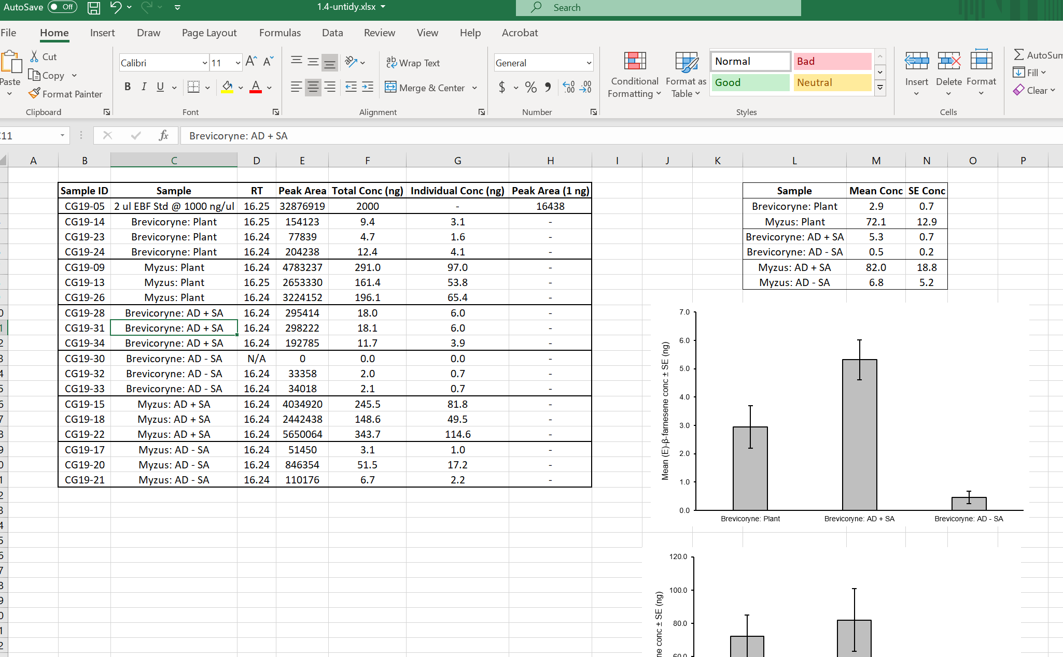
Untidy data

Slide 9
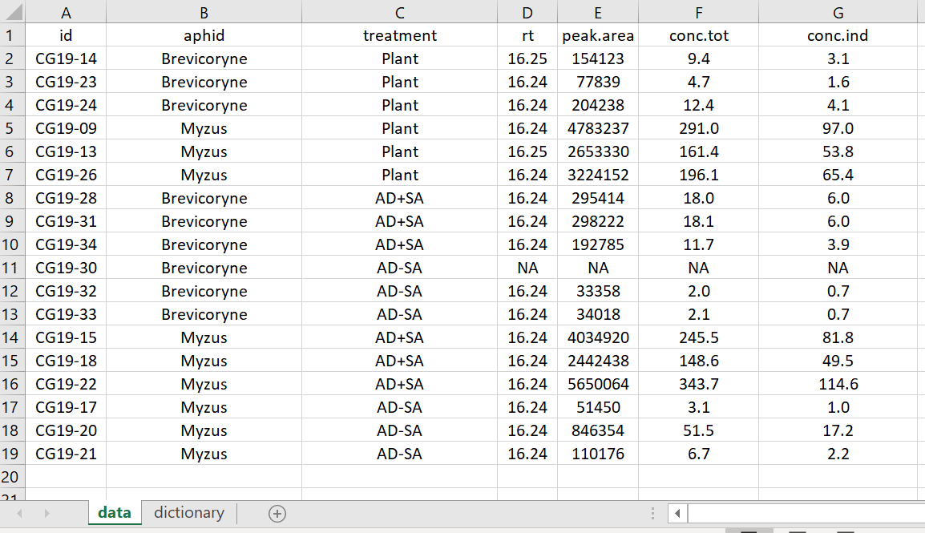
Tidy data

Slide 10
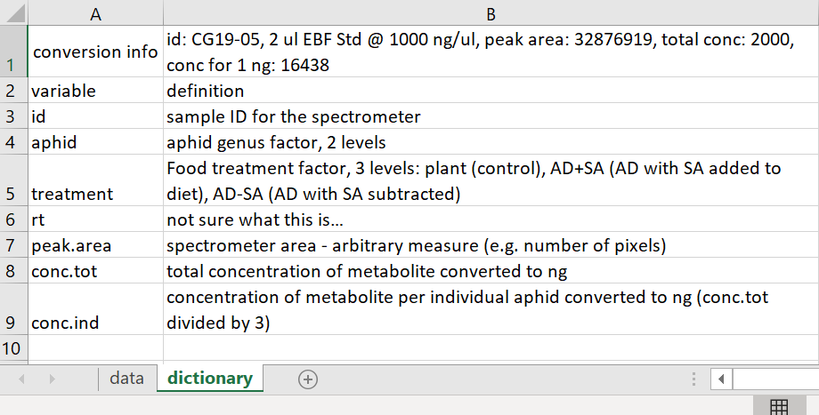
Tidy dictionary

Slide 11
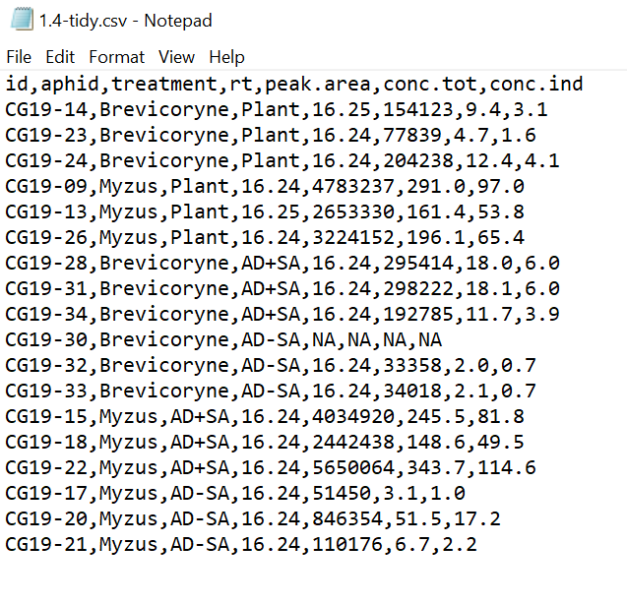
Tidy csv

Slide 12
Getting data into R
Choices
from File > Import Data
readxl::read_excel()
openxlsx::read.xlsx()
Demonstrate

Slide 13
Manipulating variables in the Data Frame
class()
names()
str()
indexes [ , ]
attach()
Demonstrate

Slide 14

Practice Exercises

